Slide 1

Artificial Intelligence
Chapter 3: Problem Solving Agent
Course Supervisor: Dr. Anaum Hamid

Slide 2
Objectives of the Chapter
• Problem Solving Agents
• Problem Formulation
• Search Strategies
• Un-informed Searching Techniques
2

Slide 3
Problem Solving Agent
Searching is one of the classic areas of AI
Problem Solving agents are one kind of goal-based agent that acts Rationally.
Problem Solving Agent
An agent that tries to come up with a sequence of actions by performing some kind of search algorithm in the background that will bring the environment into a desired state/goal.
Search
The use of search requires an abstract formulation of the problem and the available steps to construct solutions.
we need to first formulate the problem.
3

Slide 4
Problem Formulation
6.Solution
1.State
2.Initial State
3.Actions
4.Goal Test
5.Path Cost
A State Space
Set of all possible states where you can be.
A Start State. The state from where the search begins.
Actions or Successor Function
A Goal Test. A function that looks at the current state returns whether or not it is the goal state.
Solution to a search problem is a sequence of actions, called the plan that transforms the start state to the goal state.
THIS PLAN IS ACHIEVED THROUGH SEARCH ALGORITHMS

Slide 5
NOTE
Solution Quality is measured by the Path cost function, and an Optimal solution has the lowest path cost among all solutions

Slide 6
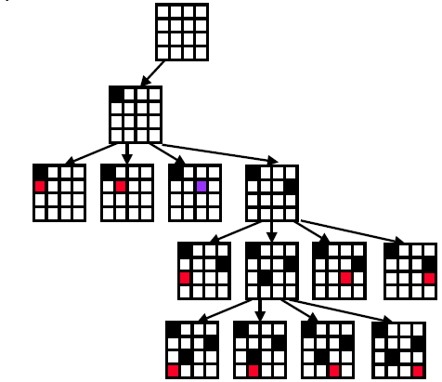
4 Queens Problem Example

Slide 7
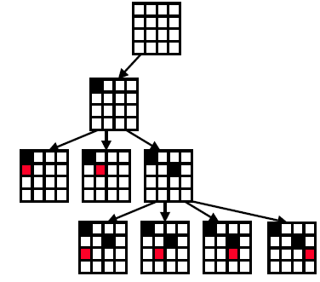
4 Queens Problem Example………

Slide 8
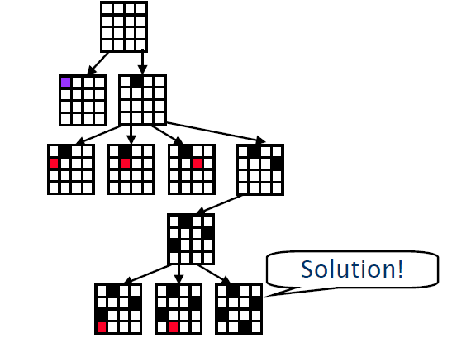
4 Queens Problem Example………

Slide 9
The 8- Puzzle Example
State: The location of the eight tiles, and the blank
Initial State: {(2,0), (8,1), (3,2),
(1,3), (6,4), (4,5), (7,6), (-,7), (5,8)}
Successor Function: four actions (blank moves Left, Right, Up, Down).
Goal Test: determine a given state is a goal state.
Path Cost: each step costs 1
Solution: {(1,0),(2,1),(3,2) ,(8,3) ,(-,4) ,(4,5) ,(7,6) ,(6,7)
,(5,8)}
2 | 8 | 3
1 | 6 | 4
7 | - | 5
1 | 2 | 3
8 | - | 4
7 | 6 | 5
Initial State
Goal State

Slide 10
2 | 8 | 3
1 | 6 | 4
7 | - | 5
2 | 8 | 3
1 | - | 4
7 | 6 | 5
1 | 2 | 3
8 | - | 4
7 | 6 | 5
2 | - | 3
1 | 8 | 4
7 | 6 | 5
- | 2 | 3
1 | 8 | 4
7 | 6 | 5
Goal
1 | 2 | 3
- | 8 | 4
7 | 6 | 5
1 | 2 | 3
8 | - | 4
7 | 6 | 5

Slide 11
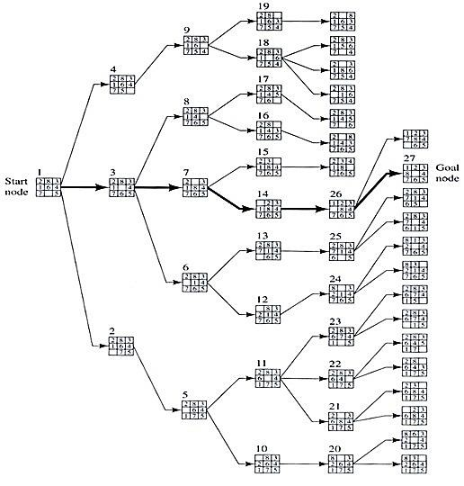

Slide 12
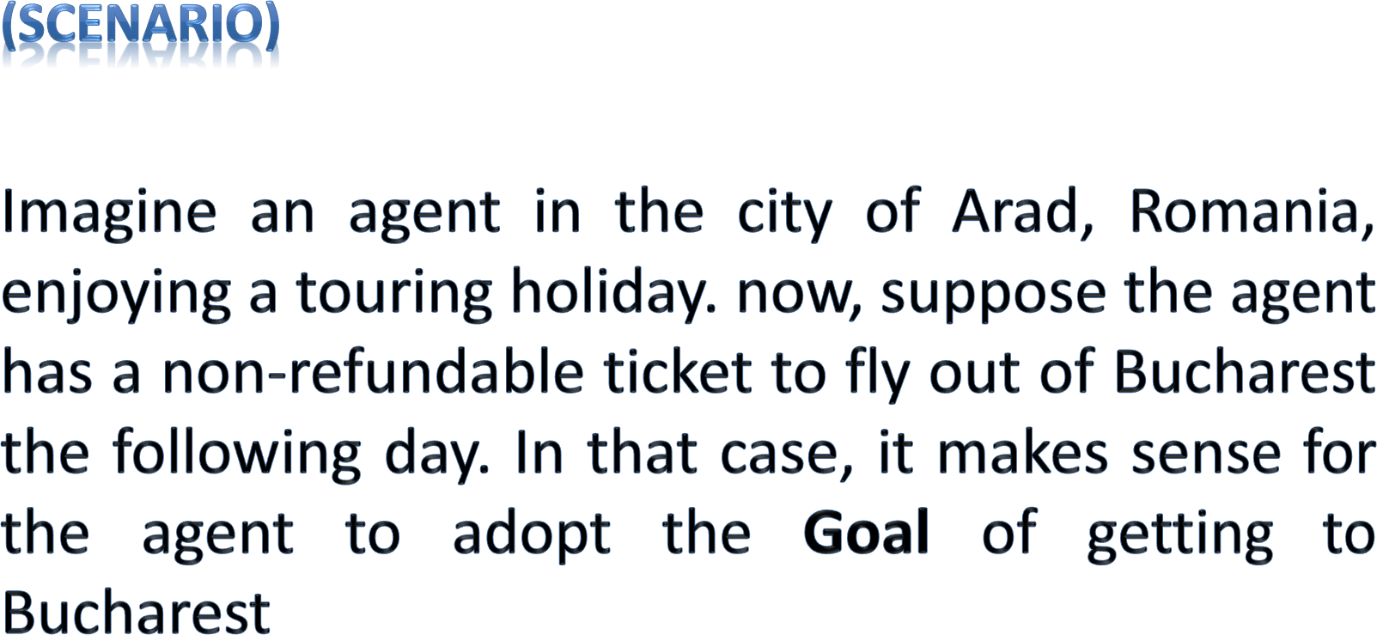

A Touring Agent Problem

Slide 13
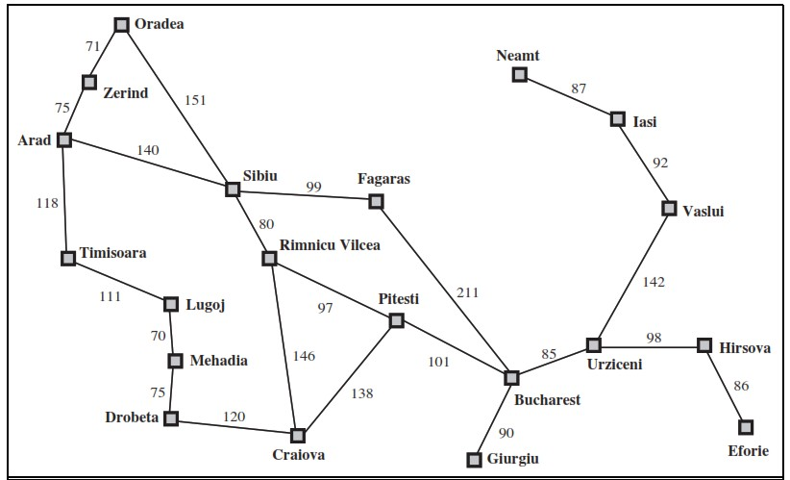
Problem Formulation (The Romania Example)
State: We regard a problem as state space, here a state is a City
Initial State: the state to start from
In (Arad)
Successor Function: description of the possible actions, give state x, S(X)
returns a set of <action, successor> ordered pairs.
S(x)= { <Go(Sibiu), In(Sibiu)>, <Go(Timisoara), In(Timisoara)>,
<Go(Zerind),In(Zerind)> }
Goal Test: determine a given state is a goal state.
In(Sibiu) →No. In(Zerind) →No.…. In(Bucharest)→Yes!
Path Cost: a function that assigns a numeric cost to each path.
e.g., sum of distances, number of actions executed, etc.
c(x,a,y) is the step cost, assumed to be ≥ 0
Solution: a sequence of actions leading from the initial state to a goal state
{Arad →Sibiu → Rimnicu Vilcea → Pitesti → Bucharest}

Slide 14
Problems
Vacuum Cleaner
8-Puzzle
8-Queens Problem
Robotic Assembly
VLSI Layout

Slide 15
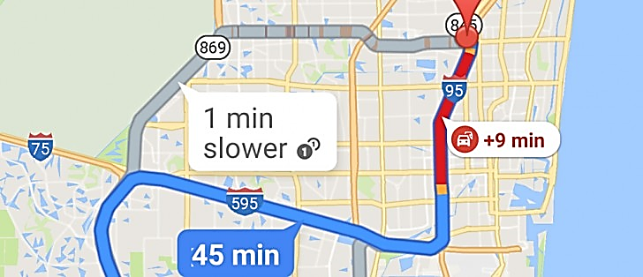
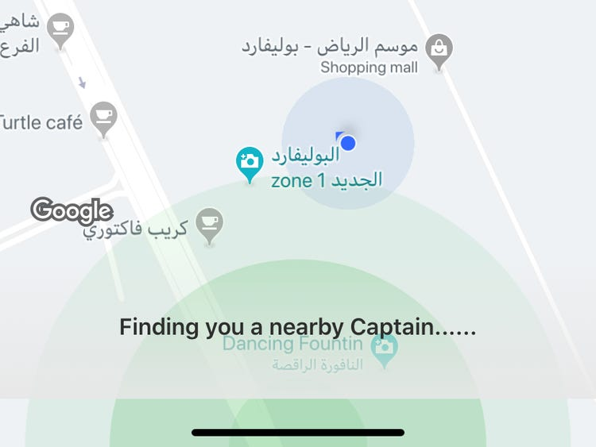
Problem Formulation (Real-life Applications)
Car Navigation
Route Finding Problem
Nearby Captain
States
locations
Initial state
starting point
Successor function (operators)
move from one location to another
Goal test
arrive at a certain location
Path cost
may be quite complex
money, time, travel comfort, scenery,

Slide 16
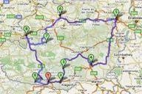
Problem Formulation (Real-life Applications)
Travel Salesperson Problem
States
locations / cities
illegal states
each city may be visited only once
visited cities must be kept as state information
Initial state
starting point
no cities visited
Successor function (operators)
move from one location to another one
Goal test
all locations visited
agent at the initial location
Path cost
–
distance between locations

Slide 17
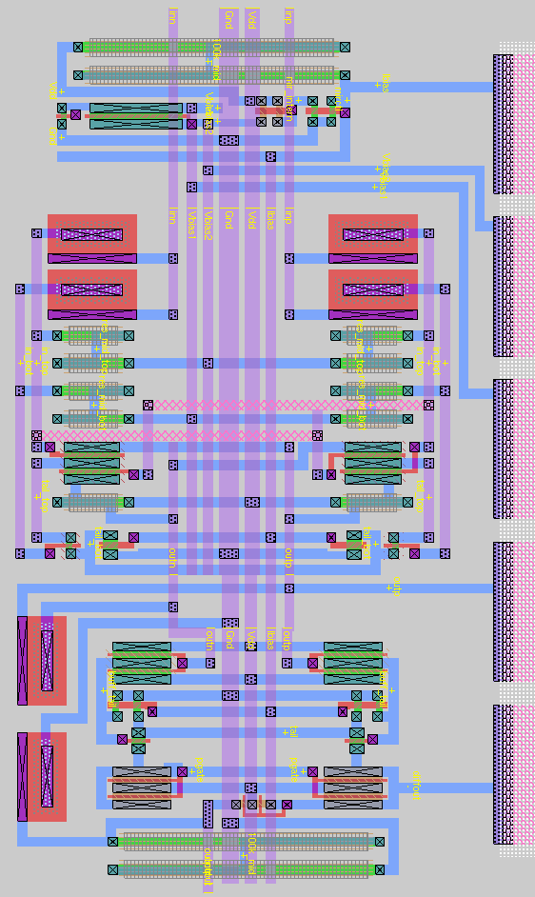
Problem Formulation (Real-life Applications)
VLSI layout Problem
States
positions of components, wires on a chip
Initial state
incremental: no components placed
complete-state: all components placed (e.g.
randomly, manually)
Successor function (operators)
incremental: place components, route wire
complete-state: move component, move wire
Goal test
all components placed
components connected as specified
Path cost
maybe complex
distance, capacity, number of connections per
component
13

Slide 18
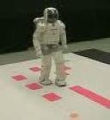
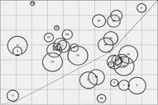
Problem Formulation (Real-life Applications)
Robot Navigation
States
locations
position of actuators
Initial state
start position (dependent on the task)
Successor function (operators)
movement, actions of actuators
Goal test
task-dependent
Path cost
maybe very complex
distance, energy consumption

Slide 19

Problem Formulation (Real-life Applications)
Automatic Assembly Sequencing
States
location of components
Initial state
no components assembled
Successor function (operators)
place component
Goal test
system fully assembled
Path cost
number of moves

Slide 20
Search Algorithms
Uninformed Search
Informed Search
Uninformed Search
breadth-first
uniform-cost search
depth-first
depth-limited search
iterative deepening
bi-directional search
Informed Search
Greedy best-first
A*
(heuristic search)
agent has background information about the problem
(blind search)
number of steps, path cost unknown
agent knows when it reaches a goal

Slide 21
Uninformed (Blind Search)
The Uninformed Search does not contain any domain knowledge such as closeness or location of goal.
It operates in a brute force way, as it only includes information about how to traverse the tree and how to identify leaf and goal nodes.
Uninformed Search applies a way in which search tree is searched without any information, so it is called blind search.
It examines each node until it achieves the goal
node.
21

Slide 22
Evaluation of Search Strategies
A search strategy is defined by picking the order of node expansion
Strategies are evaluated along the following dimensions:
Completeness: if there is a solution, will it be found
Time complexity: How long does it takes to find the
solution
Space complexity: memory required for the search
Optimality: will the best solution be found
Time and space complexity are measured in terms of
b: maximum branching factor of the search tree
d: depth of the least-cost solution
m: maximum depth of the state space (may be ∞)

Slide 23
Searching for Solutions
Traversal of the search space
From the initial state to a goal state.
Legal sequence of actions as defined by successor function.
General procedure
Check for goal state
Expand the current state
Determine the set of reachable states
Return “failure” if the set is empty
Select one from the set of reachable states
Move to the selected state
A search tree is generated
Nodes are added as more states are visited

Slide 24
Search Terminology
Search Tree
Generated as the search space is traversed
The search space itself is not necessarily a tree, frequently it is a
graph
The tree specifies possible paths through the search space
Expansion of nodes
As states are explored, the corresponding nodes are expanded by
applying the successor function
this generates a new set of (child) nodes
The fringe (frontier/queue) is the set of nodes not yet visited
newly generated nodes are added to the fringe
Search strategy
Determines the selection of the next node to be expanded
Can be achieved by ordering the nodes in the fringe
e.g. queue (FIFO), stack (LIFO), “best” node w.r.t. some measure (cost)

Slide 25
Search Tree Vs Graph Tree
BASIS FOR COMPARISON | TREE | GRAPH
Path | Only one between two vertices. | More than one path is allowed.
Root node | It has exactly one root node. | Graph doesn't have a root node.
Loops | No loops are permitted. | Graph can have loops.
Complexity | Less complex | More complex comparatively
Traversal techniques | Pre-order, In-order and Post-order. | Breadth-first search and depth-first search.
Number of edges | n-1 (where n is the number of nodes) | Not defined
Model type | Hierarchical | Network

Slide 26
1. Breadth-First Search (BFS) Algorithm

Slide 27
Breadth-First Search
It is the most common search strategy for traversing a tree or graph.
This algorithm searches breadthwise in a tree or graph, so it is called breadth-first search.
BFS algorithm starts searching from the root node of the tree and further are traversed in level-order, where we visit every node on a level before going to a lower level.
It starts at the tree root (or some arbitrary node of a graph)
BFS is implemented using FIFO Queue data structure.

Slide 28
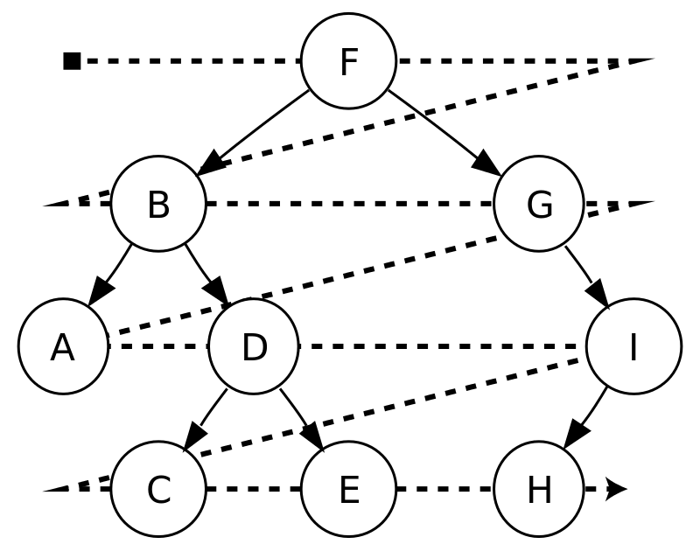
Example: BFS
For example, after searching F, then B, then G, the search proceeds with A,D, I, C, E,H
Node are explored in the Level order F,B,G,A,D,I,C,E,H

Slide 29
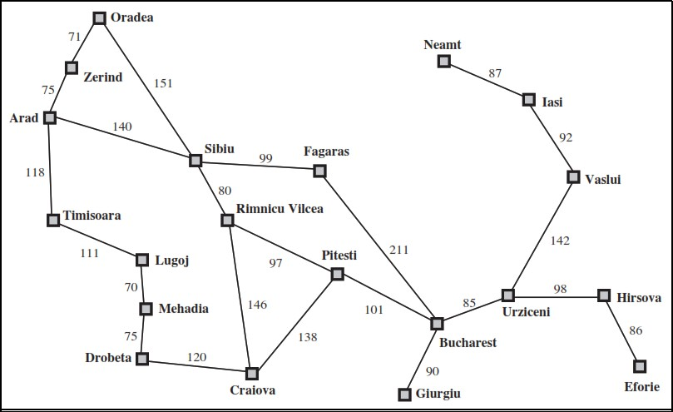
Example: Romania
You are in Arad and want to go to Bucharest
➔ How to design an intelligent agent to find the way between 2 cities?

Slide 30
Breadth-First Snapshot 1
Initial Visited Fringe Current Visible Goal
1
2
3
Fringe: [] + [2,3]

Slide 31
Breadth-First Snapshot 2
Initial Visited Fringe Current Visible Goal
1
2
3
4
5
Fringe: [3] + [4,5]

Slide 32
Breadth-First Snapshot 3
Initial Visited Fringe Current Visible Goal
1
2
3
4
5
6
7
Fringe: [4,5] + [6,7]

Slide 33
Breadth-First Snapshot 4
Initial Visited Fringe Current Visible Goal
1
2
3
4
5
6
7
8
9
Fringe: [5,6,7] + [8,9]

Slide 34
Breadth-First Snapshot 5
Initial Visited Fringe Current Visible Goal
1
2
3
4
5
6
7
8
9
10
11
Fringe: [6,7,8,9] + [10,11]

Slide 35
Breadth-First Snapshot 6
Initial Visited Fringe Current Visible Goal
1
2
3
4
5
6
7
8
9
10
11
12
13
Fringe: [7,8,9,10,11] + [12,13]

Slide 36
Breadth-First Snapshot 7
Initial Visited Fringe Current Visible Goal
1
2
3
4
5
6
7
8
9
10
11
12
13
14
15
Fringe: [8,9,10,11,12,13] + [14,15]

Slide 37
Breadth-First Snapshot 8
Initial Visited Fringe Current Visible Goal
1
2
3
4
5
6
7
8
9
10
11
12
13
14
15
16 17
Fringe: [9,10,11,12,13,14,15] + [16,17]

Slide 38
Breadth-First Snapshot 9
Initial Visited Fringe Current Visible Goal
1
2
3
4
5
6
7
8
9
10
11
12
13
14
15
16 17 18 19
Fringe: [10,11,12,13,14,15,16,17] + [18,19]

Slide 39
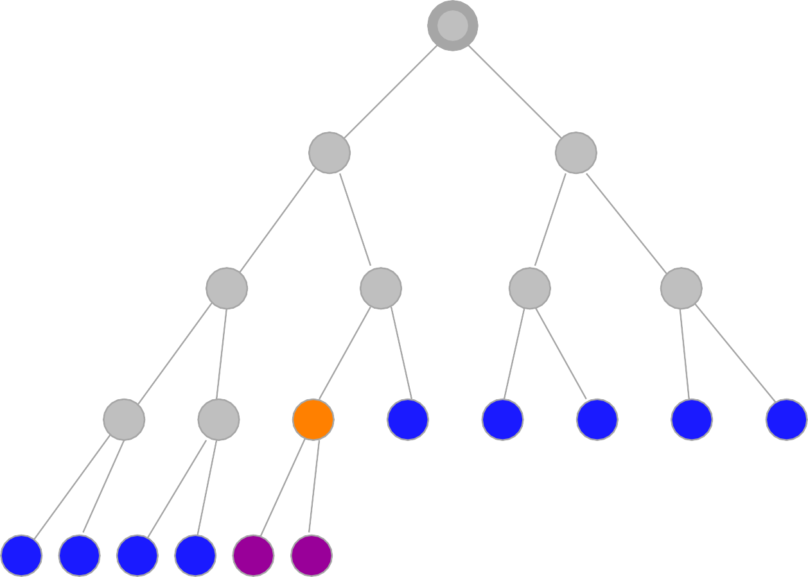
Breadth-First Snapshot 10
Initial Visited Fringe Current Visible Goal
1
2
3
4
5
6
7
8
9
10
11
12
13
14
15
16 17 18 19 20 21
Fringe: [11,12,13,14,15,16,17,18,19] + [20,21]

Slide 40
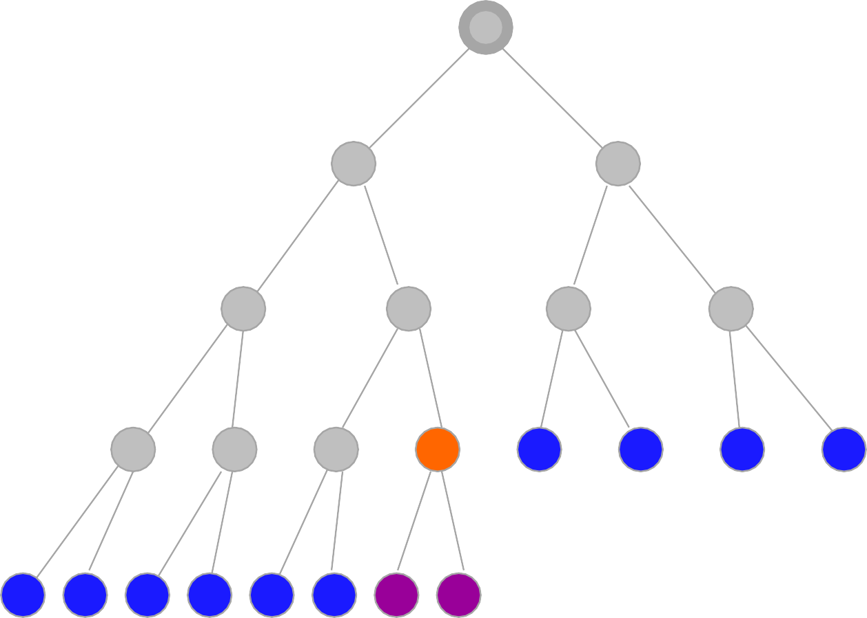
Breadth-First Snapshot 11
Initial Visited Fringe Current Visible Goal
1
2
3
4
5
6
7
8
9
10
11
12
13
14
15
16 17 18 19 20 21 22 23
Fringe: [12, 13, 14, 15, 16, 17, 18, 19, 20, 21] + [22,23]

Slide 41
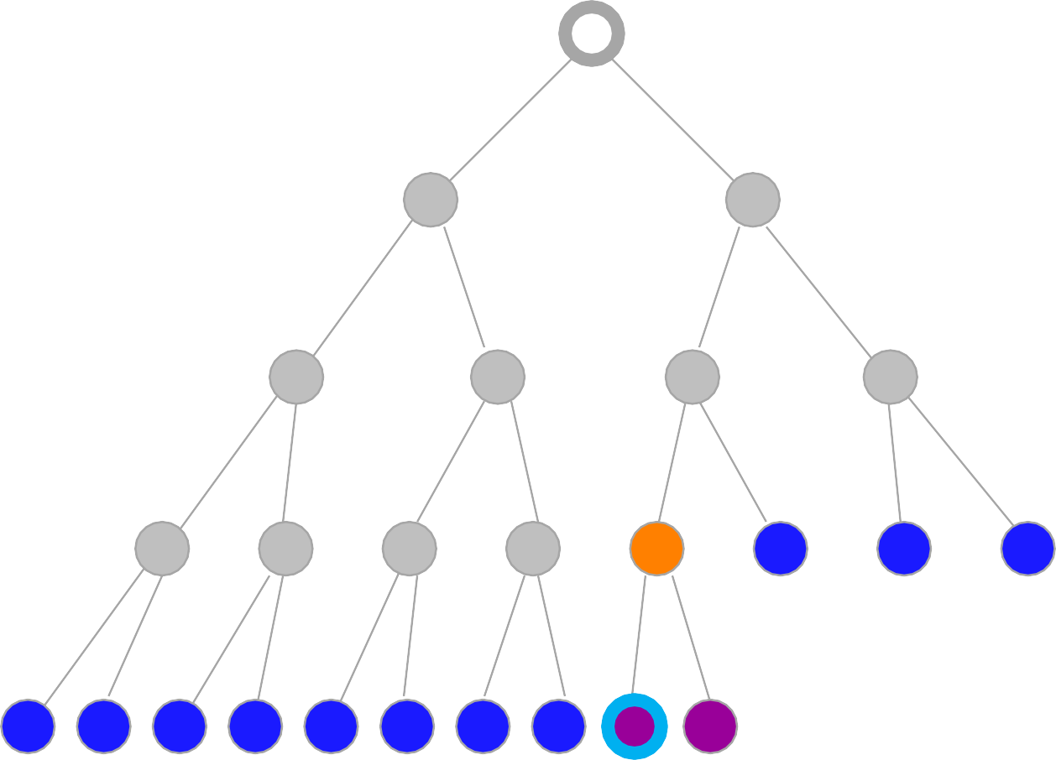
Breadth-First Snapshot 12
Initial Visited Fringe Current Visible Goal
1
2
3
4
5
6
7
Note:
The goal node is “visible” here, but we can not perform the goal test yet.
8
9
10
11
12
13
14
15
16 17 18 19 20 21 22 23 24 25
Fringe: [13,14,15,16,17,18,19,20,21] + [22,23]

Slide 42
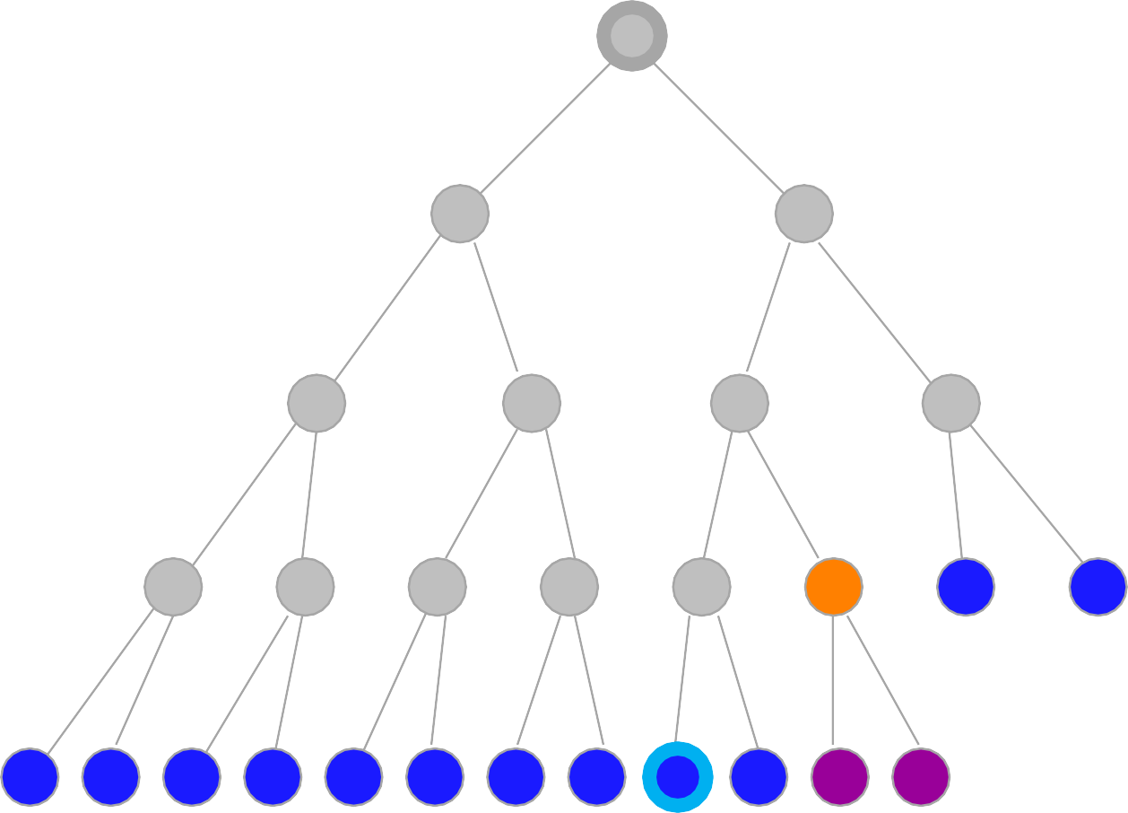
Breadth-First Snapshot 13
Initial Visited Fringe Current Visible Goal
1
2
3
4
5
6
7
8
9
10
11
12
13
14
15
16 17 18 19 20 21 22 23 24 25 26 27
Fringe: [14,15,16,17,18,19,20,21,22,23,24,25] + [26,27]

Slide 43
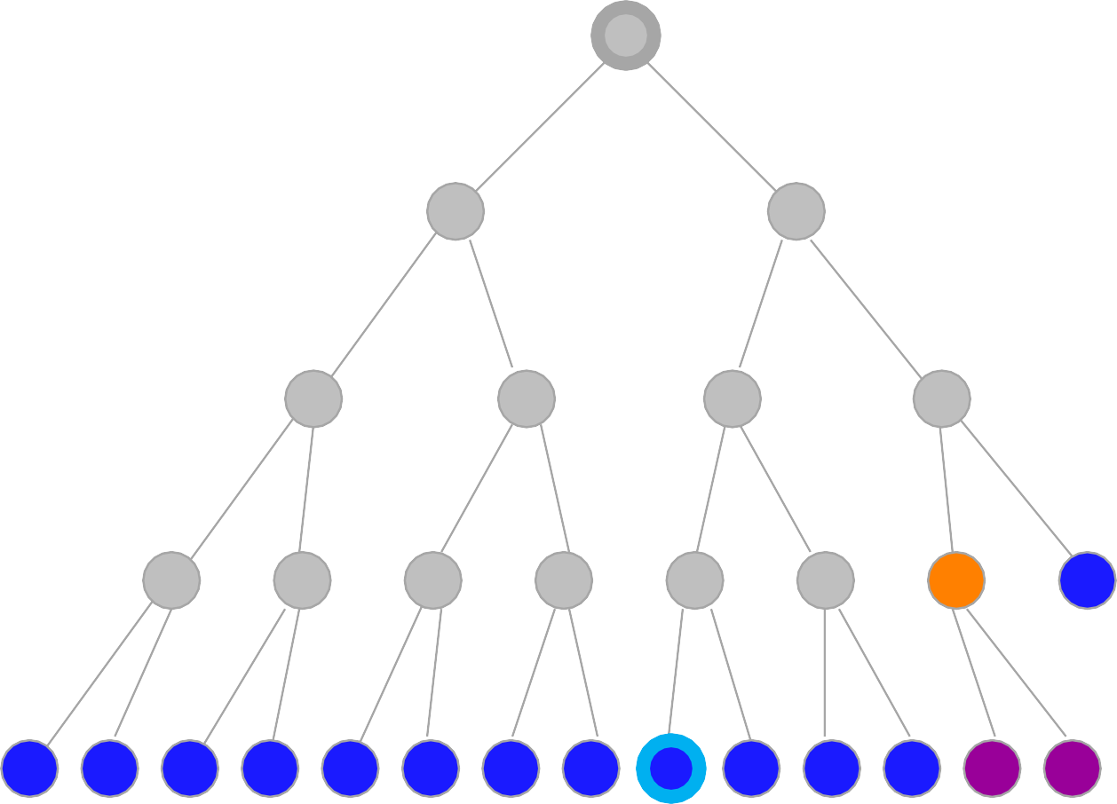
Breadth-First Snapshot 14
Initial Visited Fringe Current Visible Goal
1
2
3
4
5
6
7
8
9
10
11
12
13
14
15
16 17 18 19 20 21 22 23 24 25 26 27 28 29
Fringe: [15,16,17,18,19,20,21,22,23,24,25,26,27] + [28,29]

Slide 44
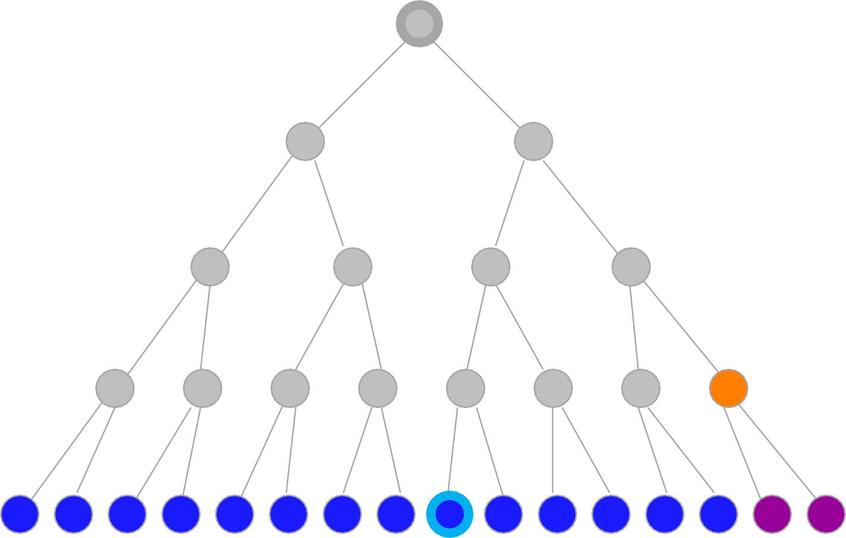
Breadth-First Snapshot 15
Initial Visited Fringe Current Visible Goal
1
2
3
4
5
6
7
8
9
10
11
12
13
14
15
16 17 18 19 20 21 22 23 24 25 26 27 28 29 30 31
Fringe: [15,16,17,18,19,20,21,22,23,24,25,26,27,28,29] + [30,31]

Slide 45
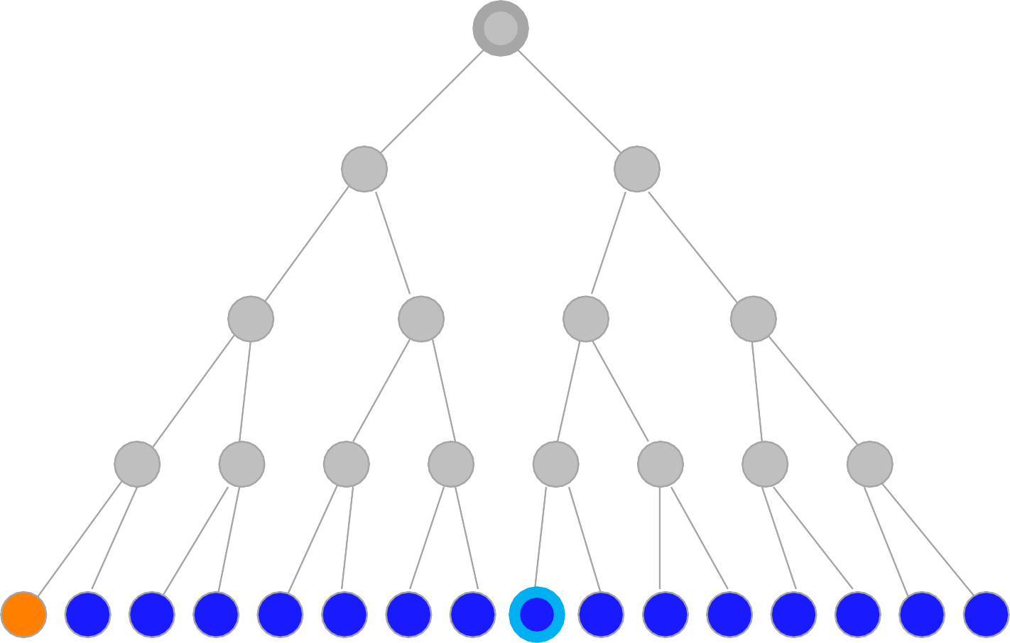
Breadth-First Snapshot 16
Initial Visited Fringe Current Visible Goal
1
2
3
4
5
6
7
8
9
10
11
12
13
14
15
16 17 18 19 20 21 22 23 24 25 26 27 28 29 30 31
Fringe: [17,18,19,20,21,22,23,24,25,26,27,28,29,30,31]

Slide 46
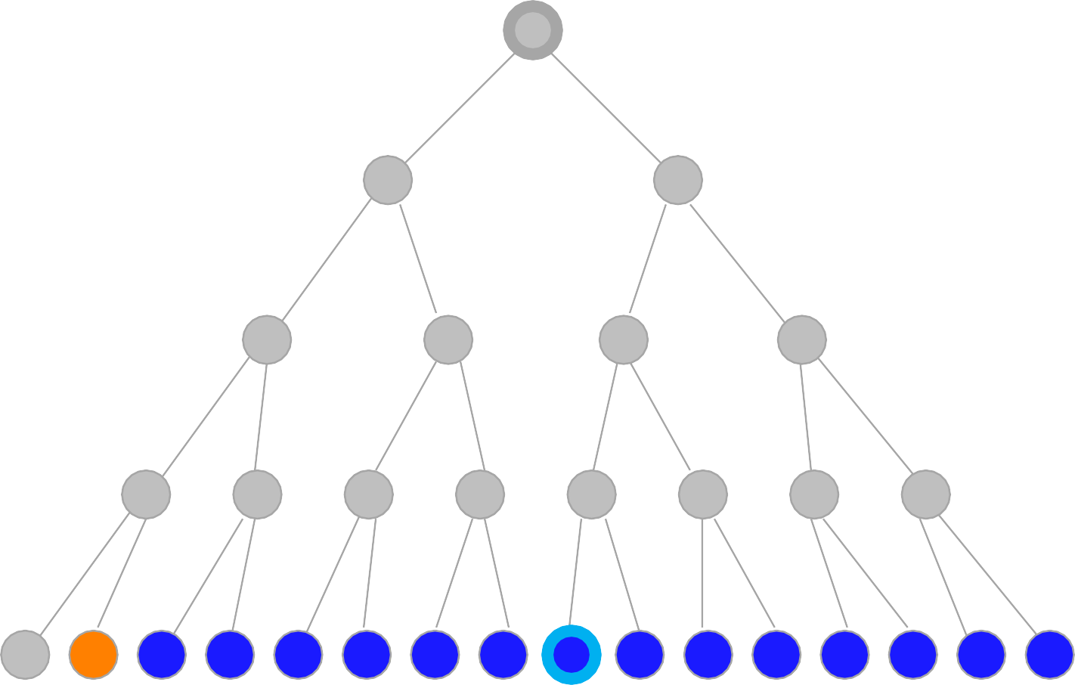
Breadth-First Snapshot 17
Initial Visited Fringe Current Visible Goal
1
2
3
4
5
6
7
8
9
10
11
12
13
14
15
16 17 18 19 20 21 22 23 24 25 26 27 28 29 30 31
Fringe: [18,19,20,21,22,23,24,25,26,27,28,29,30,31]

Slide 47
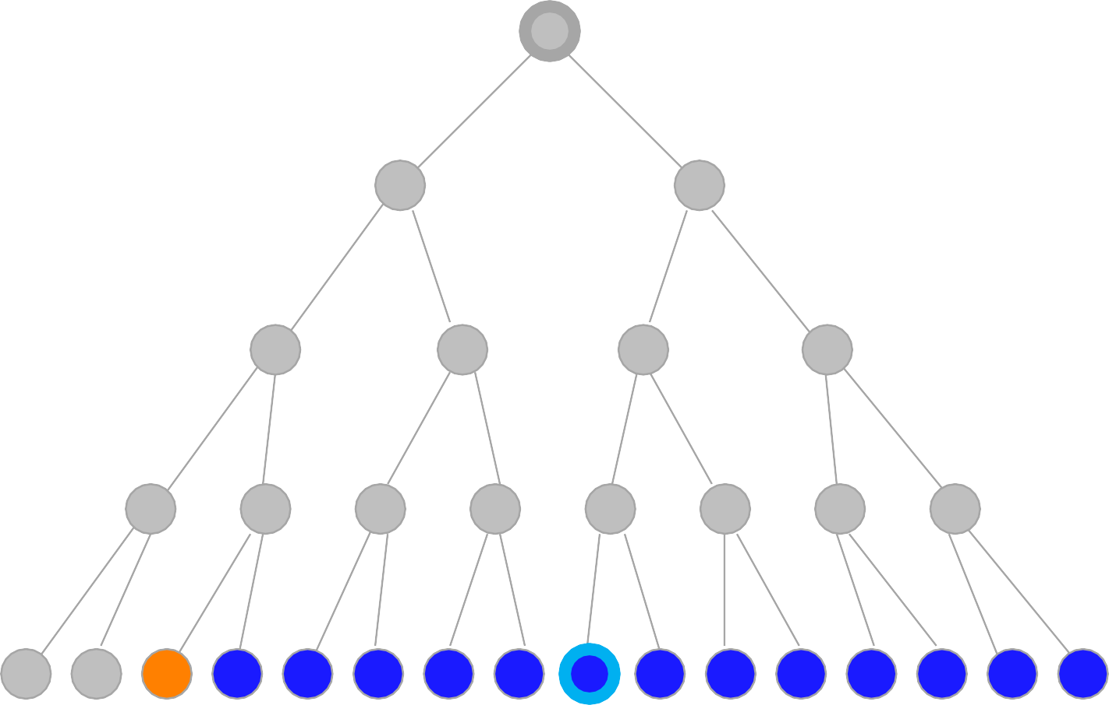
Breadth-First Snapshot 18
Initial Visited Fringe Current Visible Goal
1
2
3
4
5
6
7
8
9
10
11
12
13
14
15
16 17 18 19 20 21 22 23 24 25 26 27 28 29 30 31
Fringe: [19,20,21,22,23,24,25,26,27,28,29,30,31]

Slide 48
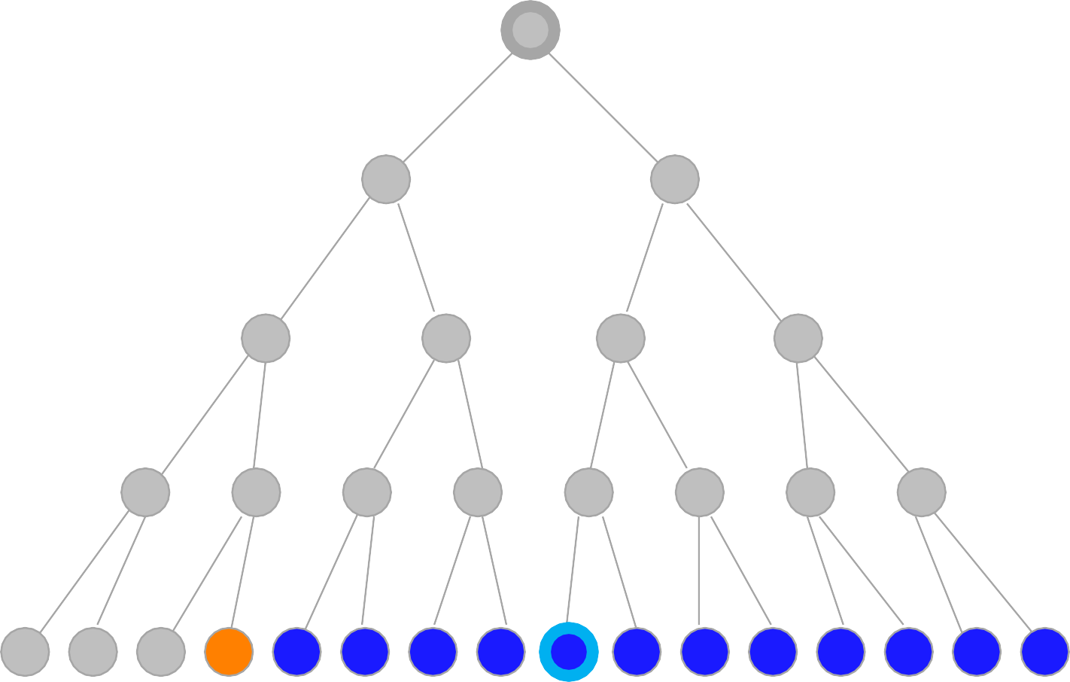
Breadth-First Snapshot 19
Initial Visited Fringe Current Visible Goal
1
2
3
4
5
6
7
8
9
10
11
12
13
14
15
16 17 18 19 20 21 22 23 24 25 26 27 28 29 30 31
Fringe: [20,21,22,23,24,25,26,27,28,29,30,31]

Slide 49
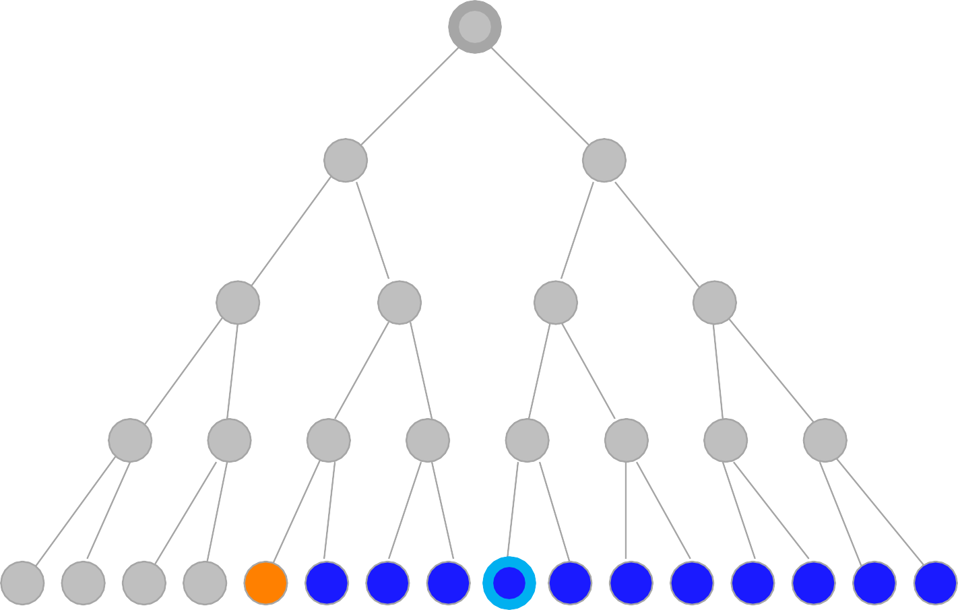
Breadth-First Snapshot 20
Initial Visited Fringe Current Visible Goal
1
2
3
4
5
6
7
8
9
10
11
12
13
14
15
16 17 18 19 20 21 22 23 24 25 26 27 28 29 30 31
Fringe: [21,22,23,24,25,26,27,28,29,30,31]

Slide 50
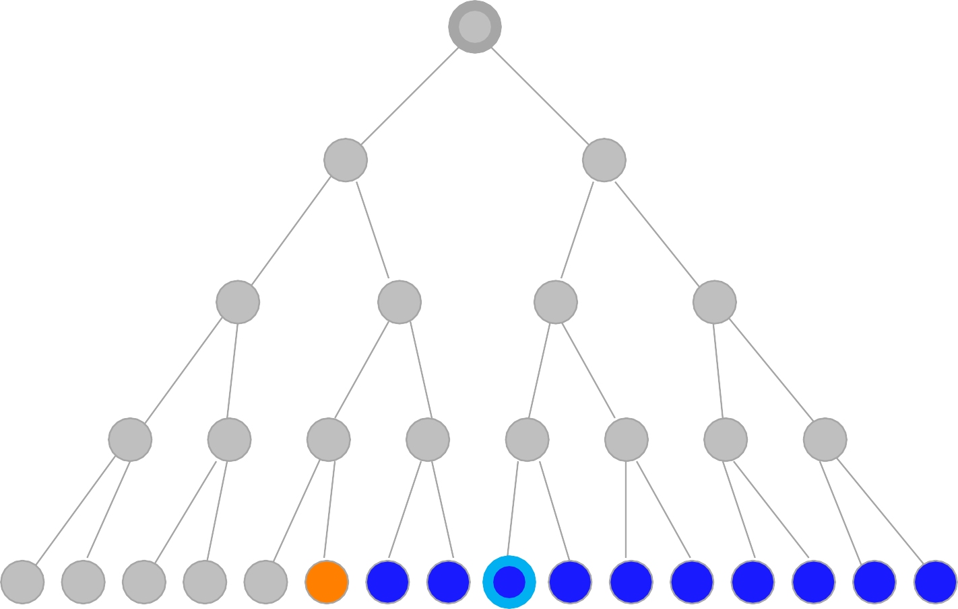
Breadth-First Snapshot 21
Initial Visited Fringe Current Visible Goal
1
2
3
4
5
6
7
8
9
10
11
12
13
14
15
16 17 18 19 20 21 22 23 24 25 26 27 28 29 30 31
Fringe: [22,23,24,25,26,27,28,29,30,31]

Slide 51
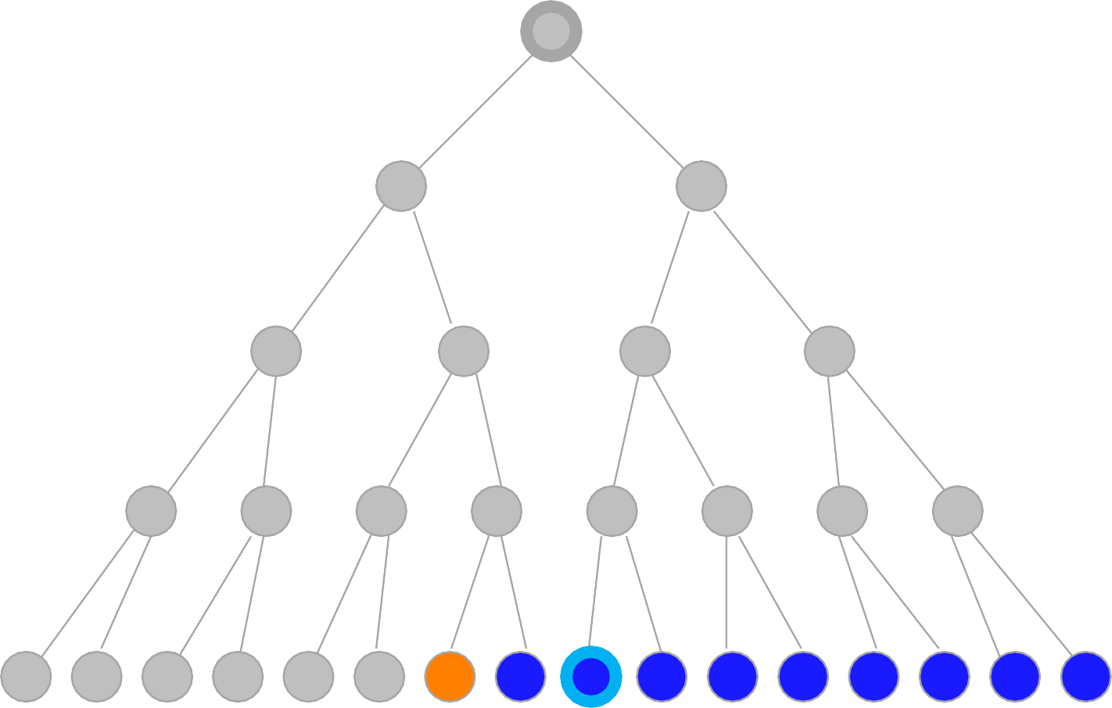
Breadth-First Snapshot 22
Initial Visited Fringe Current Visible Goal
1
2
3
4
5
6
7
8
9
10
11
12
13
14
15
16 17 18 19 20 21 22 23 24 25 26 27 28 29 30 31
Fringe: [23,24,25,26,27,28,29,30,31]

Slide 52
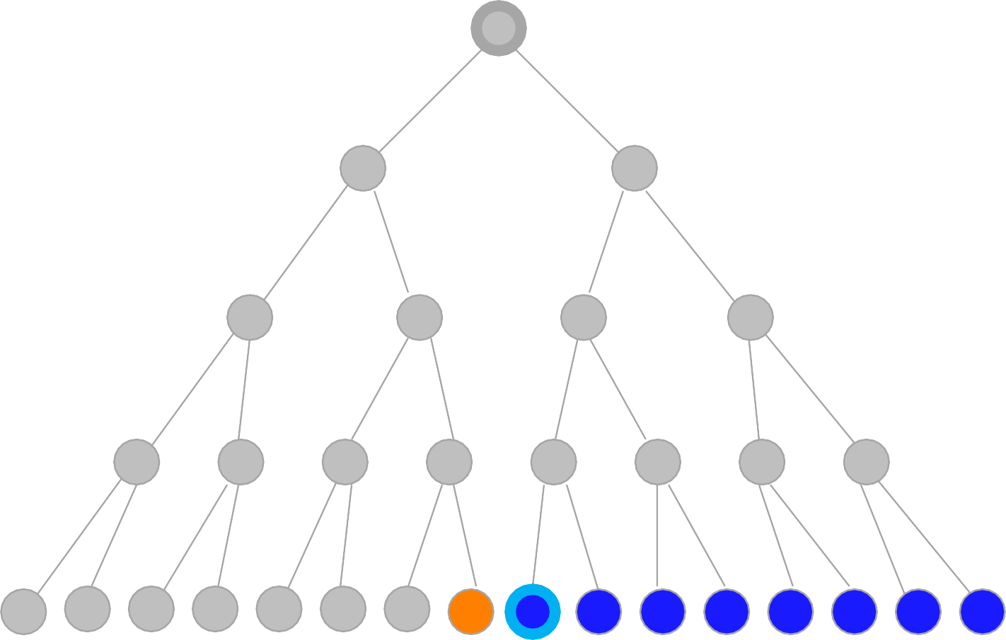
Breadth-First Snapshot 23
Initial Visited Fringe Current Visible Goal
1
2
3
4
5
6
7
8
9
10
11
12
13
14
15
16 17 18 19 20 21 22 23 24 25 26 27 28 29 30 31
Fringe: [24,25,26,27,28,29,30,31]

Slide 53
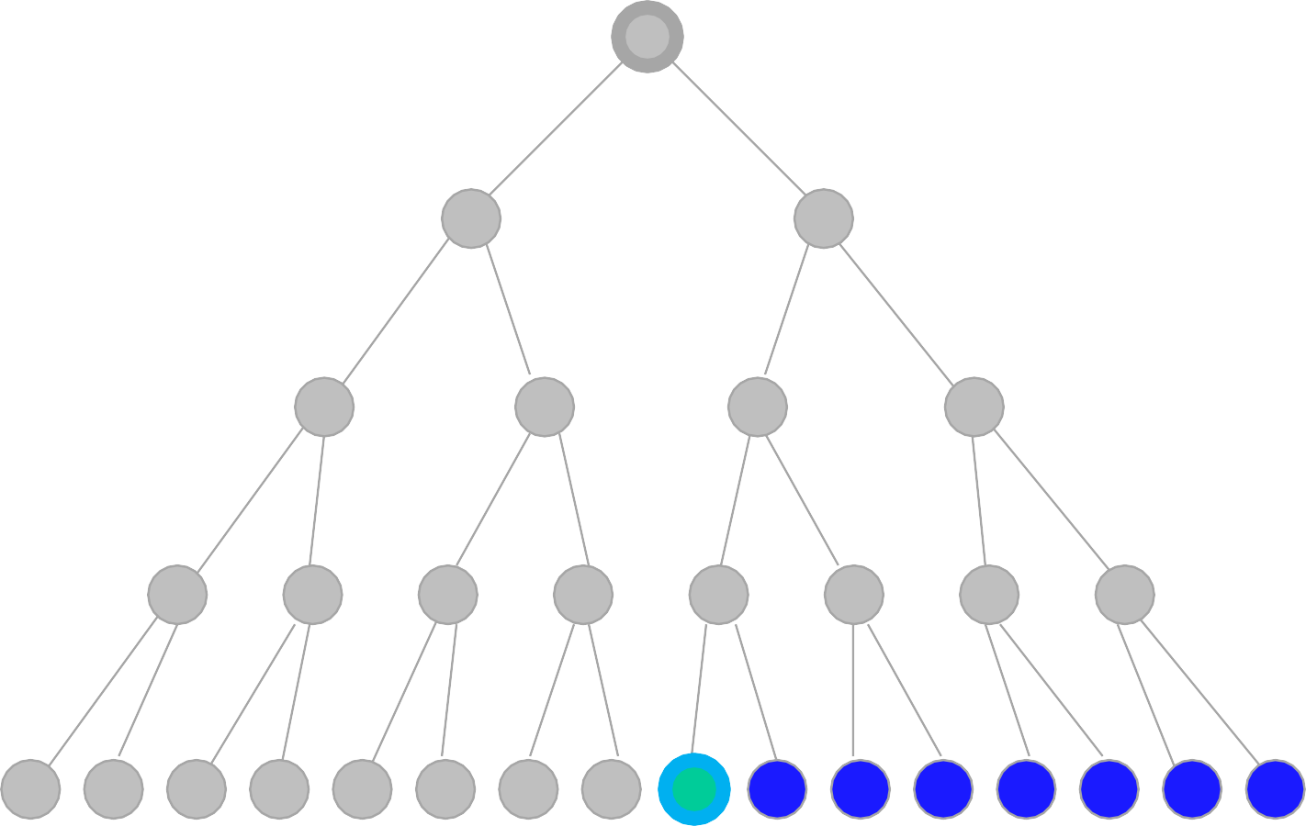
Breadth-First Snapshot 24
Initial Visited Fringe Current Visible Goal
1
2
3
4
5
6
7
Note:
The goal test is positive for this node, and
a solution is found in 24 steps.
8
9
10
11
12
13
14
15
16 17 18 19 20 21 22 23 24 25 26 27 28 29 30 31
Fringe: [25,26,27,28,29,30,31]

Slide 54
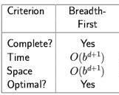
Properties of Breadth-First Search (BFS)
Completeness: Yes (if b is finite), a solution will be found if exists.
Time Complexity: (nodes until the solution) Optimality: Yes
b d
Branching Factor The depth of the goal
Suppose the branching factor b=3, and the goal is at depth d=20:
– Then we need 3²⁰ time to finish.
➔Not suitable for searching large graphs

Slide 55
2- Uniform-Cost -First

Slide 56
The primary goal of the uniform-cost search is to find a path to the goal node which has the lowest cumulative cost. Uniform-cost search expands nodes according to their path costs form the root node. It can be used to solve any graph/tree where the optimal cost is in demand. Uniform cost search is equivalent to BFS algorithm if the path cost of all edges is the same.
Uniform-Cost -First

Slide 57
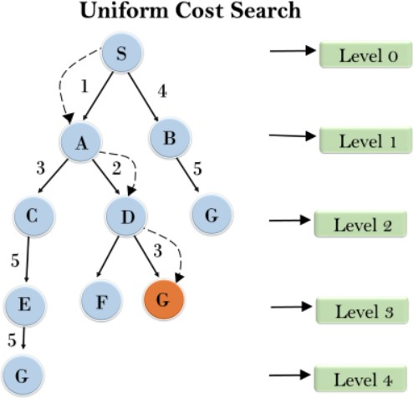

Slide 58
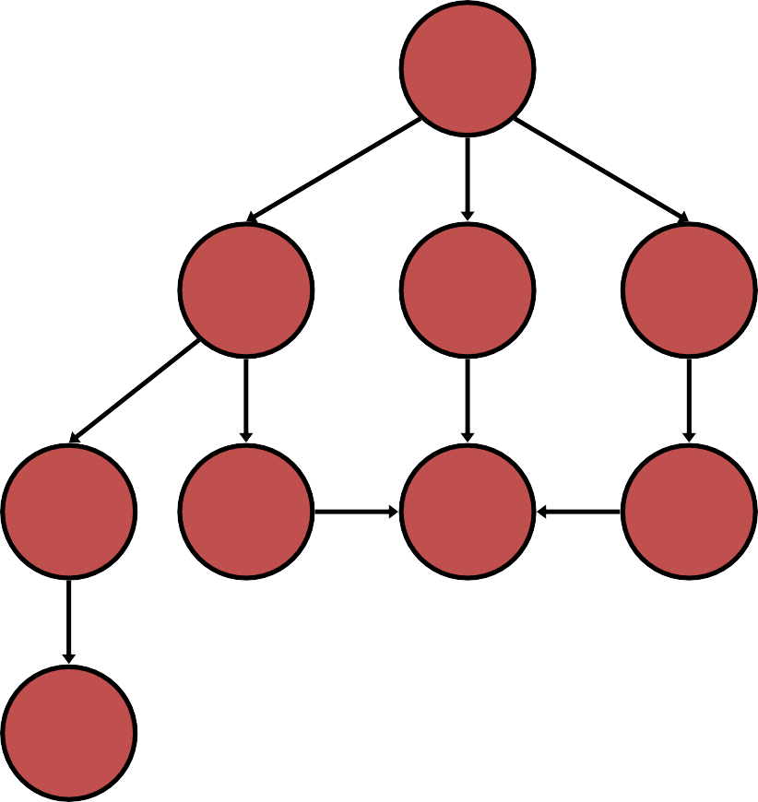
Uniform-Cost Search (UCS)
generalSearch(problem, priorityQueue)
# of nodes tested: 0, expanded: 0
S
start
Closed Node | Open Node
 | {S}
5
2
4
A
B
C
9
4
6
G
goal
2
6
1
D
E
F
7
H
58

Slide 59
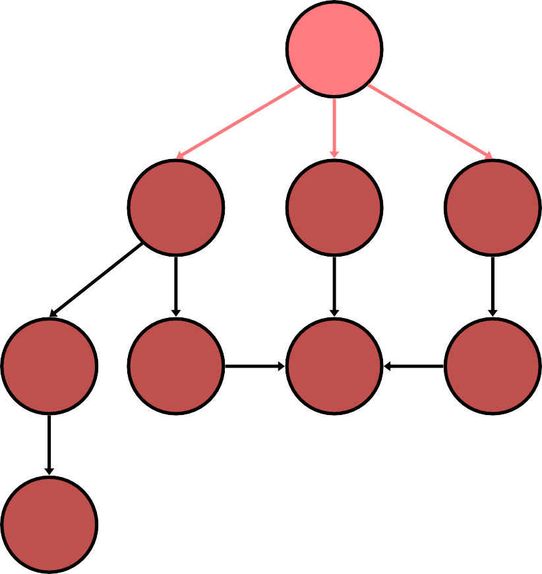
Uniform-Cost Search (UCS)
generalSearch(problem, priorityQueue)
# of nodes tested: 1, expanded: 1
S
start
Closed Node | Open Node
 | {S:0}
S not goal | {B:2,C:4,A:5}
5
2
4
A
B
C
9
4
6
G
goal
2
6
1
D
E
F
7
H
59

Slide 60
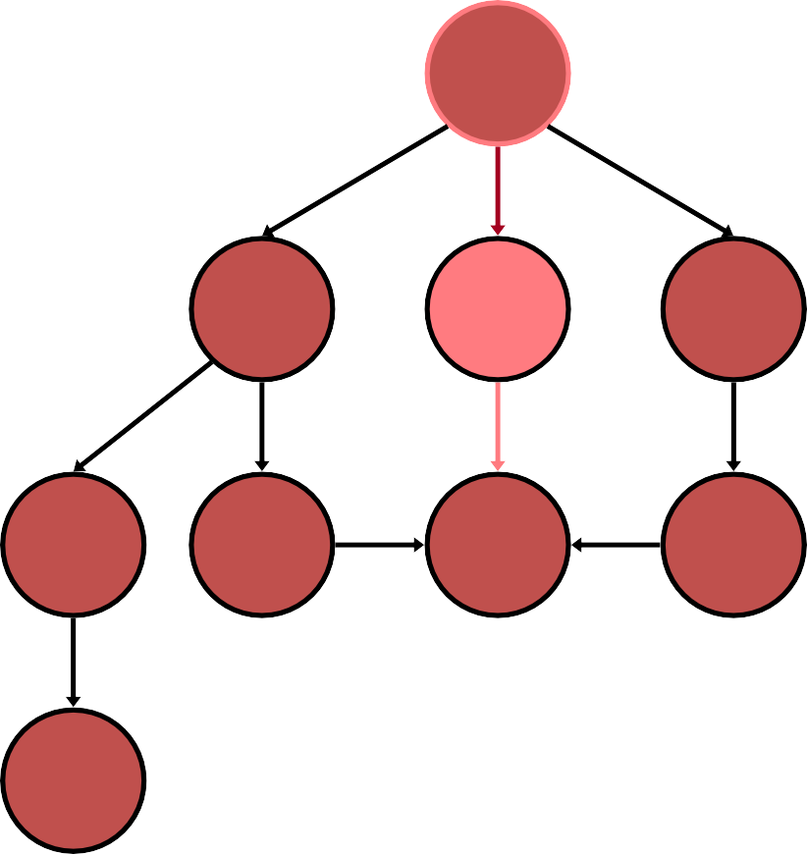
Uniform-Cost Search (UCS)
generalSearch(problem, priorityQueue)
# of nodes tested: 2, expanded: 2
S
start
Closed Node | Open Node
 | {S}
S | {B:2,C:4,A:5}
B not goal | {C:4,A:5,G:2+6}
5
2
4
A
B
C
9
4
6
G
goal
2
6
1
D
E
F
7
H
60

Slide 61
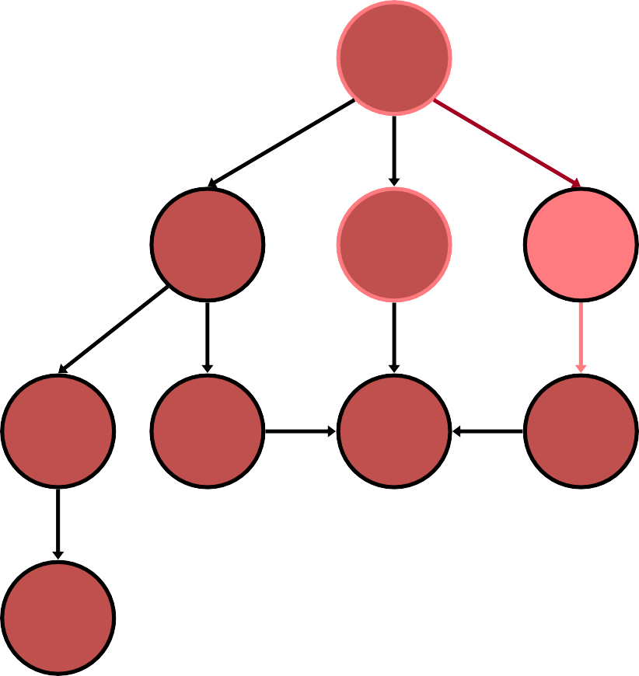
Uniform-Cost Search (UCS)
generalSearch(problem, priorityQueue)
# of nodes tested: 3, expanded: 3
S
start
Closed Node | Open Node
 | {S}
S | {B:2,C:4,A:5}
B | {C:4,A:5,G:8}
C not goal | {A:5,F:4+2,G:8}
5
2
4
A
B
C
9
4
6
G
goal
2
6
1
D
E
F
7
H
61

Slide 62
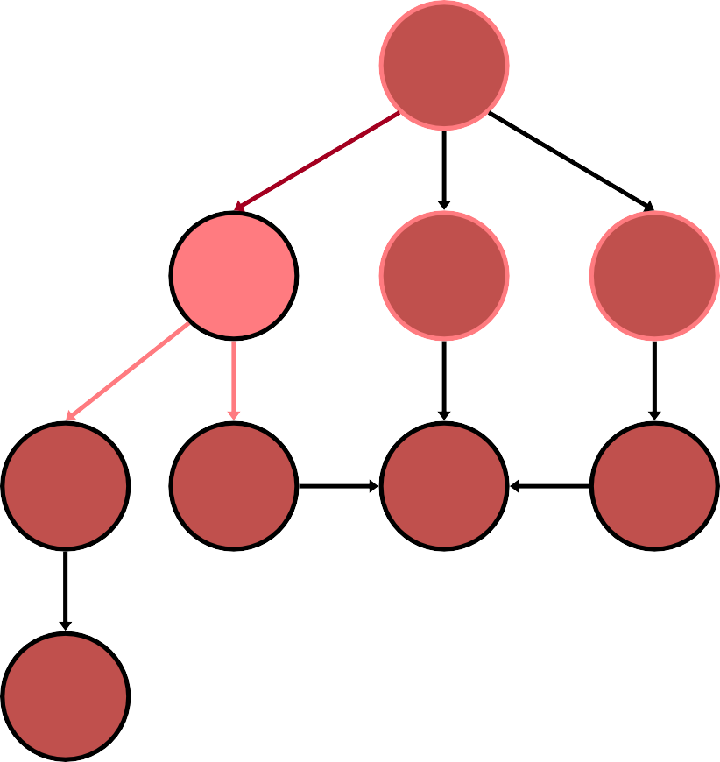
Uniform-Cost Search (UCS)
generalSearch(problem, priorityQueue)
# of nodes tested: 4, expanded: 4
S
start
Closed Node | Open Node
 | {S}
S | {B:2,C:4,A:5}
B | {C:4,A:5,G:8}
C | {A:5,F:6,G:8}
A not goal | {F:6,G:8,E:5+4, D:5+9}
5
2
4
A
B
C
9
4
6
G
goal
2
6
1
D
E
F
7
H
62

Slide 63
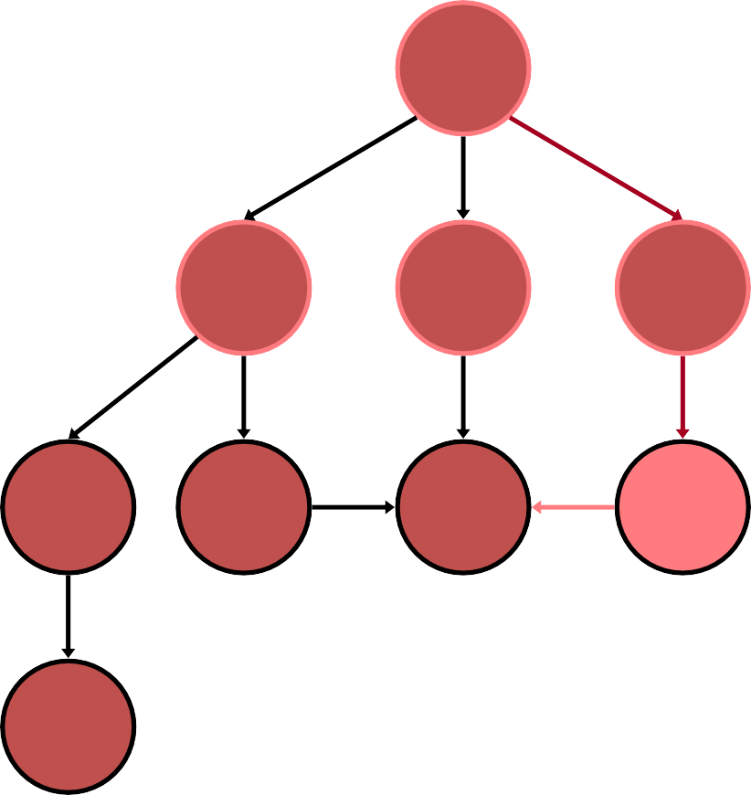
Uniform-Cost Search (UCS)
generalSearch(problem, priorityQueue)
# of nodes tested: 5, expanded: 5
S
start
Closed Node | Open Node
 | {S}
S | {B:2,C:4,A:5}
B | {C:4,A:5,G:8}
C | {A:5,F:6,G:8}
A | {F:6,G:8,E:9,D:14}
F not goal | {G:4+2+1,G:8,E:9,D:1 4}
5
2
4
A
B
C
9
4
6
G
goal
2
6
1
D
E
F
7
H
63

Slide 64
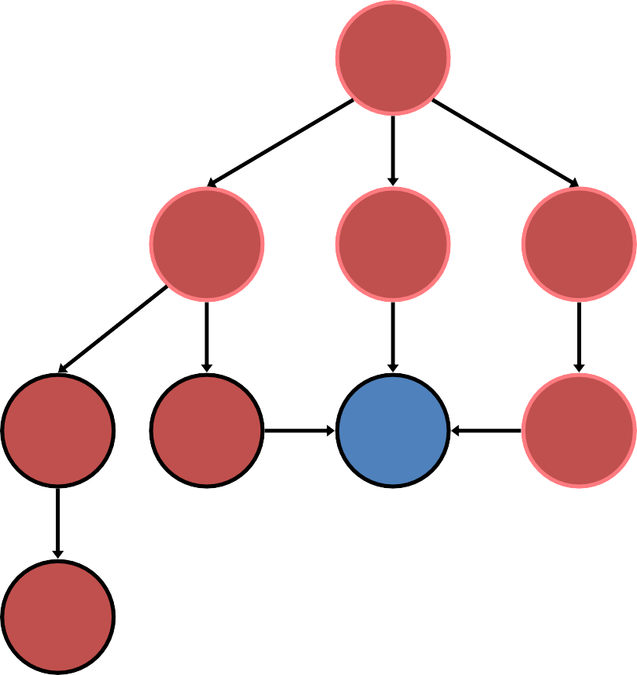
Uniform-Cost Search (UCS)
generalSearch(problem, priorityQueue)
# of nodes tested: 6, expanded: 5
S
start
Closed Node | Open Node
 | {S}
S | {B:2,C:4,A:5}
B | {C:4,A:5,G:8}
C | {A:5,F:6,G:8}
A | {F:6,G:8,E:9,D:14}
F | {G:7,G:8,E:9,D:14}
G goal | {G:8,E:9,D:14} no expand
5
2
4
A
B
C
9
4
6
G
goal
2
6
1
D
E
F
7
H
64

Slide 65
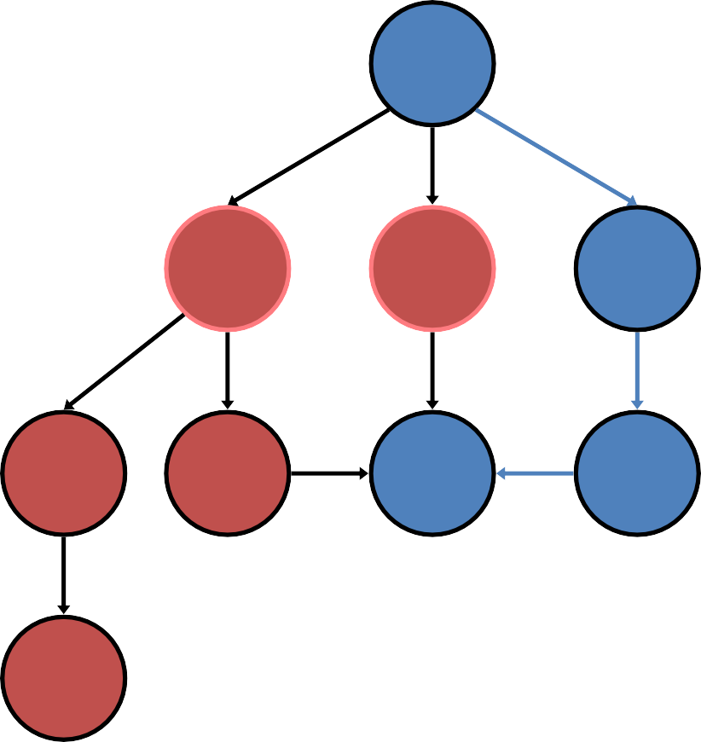
Uniform-Cost Search (UCS)
generalSearch(problem, priorityQueue)
# of nodes tested: 6, expanded: 5
S
start
Closed Node | Open Node
 | {S}
S | {B:2,C:4,A:5}
B | {C:4,A:5,G:8}
C | {A:5,F:6,G:8}
A | {F:6,G:8,E:9,D:14}
F | {G:7,G:8,E:9,D:14}
G | {G:8,E:9,D:14}
5
2
4
A
B
C
9
4
6
G
goal
2
6
1
D
E
F
7
path: S,C,F,G cost: 7
H
65

Slide 66
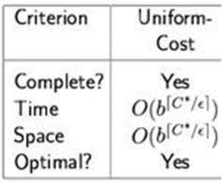
Properties of Uniform-cost Search (UCS)
Completeness Yes (if b is finite, and step cost is positive)
Time Complexity much larger than b^{d}, and just b^{d} if all steps have the same cost.
Space Complexity: as above
Optimality: Yes
b d
Branching Factor Depth of the goal/tree
Requires that the goal test being applied when a node is removed from the nodes list rather than when the node is first generated while its parent node is expanded.

Slide 67
Breadth-First vs. Uniform-Cost
Breadth-first search (BFS) is a special case of uniform-cost
search when all edge costs are positive and identical.
Breadth-first always expands the shallowest node
Only optimal if all step-costs are equal
Uniform-cost considers the overall path cost
Optimal for any (reasonable) cost function
non-zero, positive
Gets stuck down in trees with many fruitless, short branches
low path cost, but no goal node
Both are complete for non-extreme problems
Finite number of branches
Strictly positive search function

Slide 68
3- Depth-First Search

Slide 69
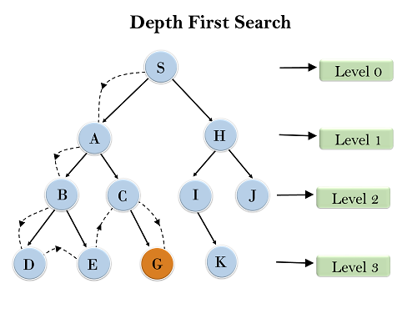
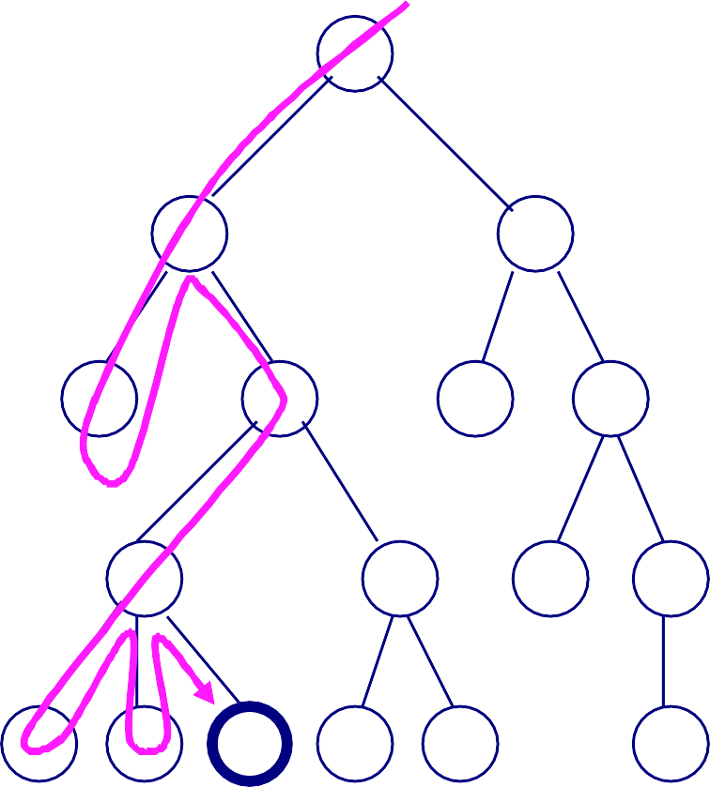
Depth-First Search
Based on [4]
A
It will start searching from root node S, and traverse A, then B, then D and E, after traversing E, it will backtrack the tree as E has no other successor and still goal node is not found.
After backtracking it will traverse node C and then G, and here it will terminate as it found goal node.
B
C
D
E
F G
H
I
J K
L M N O P
Q

Slide 70
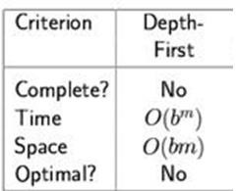
Properties of Depth-First Search
Complete: No: fails in infinite-depth spaces, spaces with loops
– Yes, complete in finite spaces
Time: O(b^{m}): terrible if m is much larger than d
– but if solutions are dense, may be much faster than breadth-first
Space: O(bm)
Optimal: No

Slide 71
4- Depth-Limited Search

Slide 72
4- Depth-Limited Search
A depth-limited search algorithm is similar to depth-first search with a predetermined limit.
Depth-limited search can solve the drawback of the infinite path in the Depth-first search.
In this algorithm, the node at the depth limit will treat as it has no successor nodes further.
Depth-limited search can be terminated with two Conditions of failure:
Standard failure value: It indicates that problem does not have any solution.
Cutoff failure value: It defines no solution for the problem within a given depth limit.

Slide 73
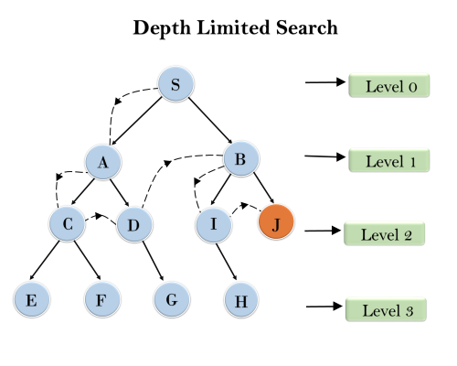
Example

Slide 74
4- Example DLS
Depth = 2
ABCFEDG
A
B
C
D
E
F
G
H

Slide 75
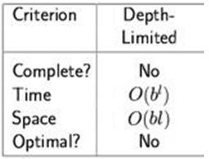
4- Depth-Limited Search
Similar to depth-first, but with a limit
i.e., nodes at depth l have no successors
Overcomes problems with infinite paths
Sometimes a depth limit can be inferred or estimated from the problem description
In other cases, a good depth limit is only known when the
problem is solved
must keep track of the depth
Complete? no (if goal beyond l (l<d), or infinite branch length)
Time? O(b^{l)}
Space? O(bl)
Optimal? No (if l < d)
b branching factor l depth limit

Slide 76
5- Iterative Deepening Depth-First Search

Slide 77
5- Iterative Deepening Depth-First Search
The iterative deepening algorithm is a combination of DFS and BFS algorithms.
This search algorithm finds out the best depth limit and does it by gradually increasing the limit until a goal is found.
This algorithm performs depth-first search up to a certain "depth limit", and it keeps increasing the depth limit after each iteration until the goal node is found.
This Search algorithm combines the benefits of Breadth-first search's fast search and depth-first search's memory efficiency.
The iterative search algorithm is useful uninformed search when search space is large, and depth of goal node is unknown.

Slide 78
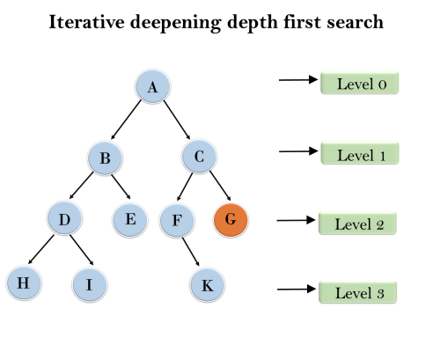
5- Iterative Deepening Depth-First Search
1'st Iteration-----> A
2'nd Iteration----> A, B, C
3'rd Iteration------>A, B, D, E, C, F, G
4'th Iteration------>A, B, D, H, I, E, C, F, K, G In the fourth iteration, the algorithm will find the goal node.

Slide 79
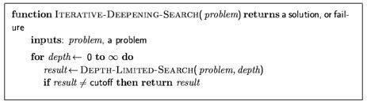
Iterative Deepening Depth-First Search
Applies LIMITED-DEPTH with increasing depth limits
Combines advantages of BREADTH-FIRST and DEPTH- FIRST
It searches to depth 0 (root only), then if that fails it searches to depth 1, then depth 2, etc.

Slide 80
Iterative deepening search l =0

Slide 81
Iterative deepening search l =1

Slide 82
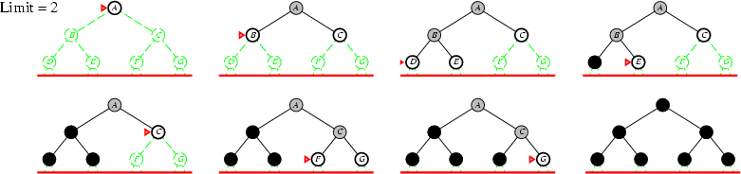
Iterative deepening search l =2

Slide 83
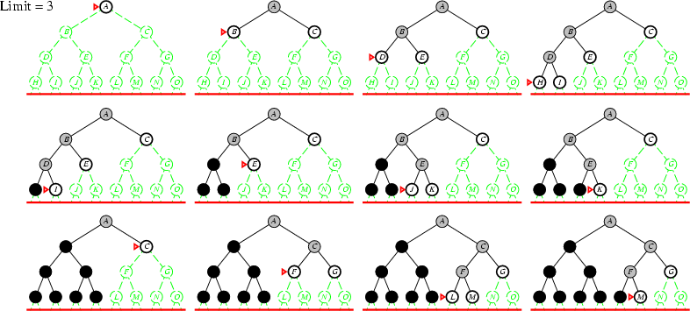
Iterative deepening search l =3

Slide 84
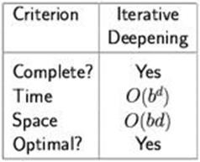
Properties of Iterative Deepening Search
Complete: Yes (if the b is finite)
Time: (d+1)b⁰ + d b¹ + (d-1)b² + … + b^{d} = O(b^{d})
Space: O(bd)
Optimal: Yes, if step cost = 1
b branching factor d Tree/goal depth

Slide 85
6- Bi-directional Search

Slide 86
6- Bi-directional Search
Bidirectional search algorithm runs two simultaneous searches, one form initial state called as forward-search and other from goal node called as backward-search, to find the goal node.
Bidirectional search replaces one single search graph with two small subgraphs in which one starts the search from an initial vertex and other starts from goal vertex.
The search stops when these two graphs intersect each other.
Bidirectional search can use search techniques such as BFS, DFS, etc.

Slide 87
6- Bi-directional Search
Both search forward from initial state, and backwards from goal.
Stop when the two searches meet in the middle.
Motivation: b^{d/2} + b^{d/2} is much less than b^{d}
Implementation
Replace the goal test with a check to see whether the
frontiers of the two searches intersect, if yes → solution is found

Slide 88

Bi-directional Search Example

Slide 89

6- Bi-directional Search
S
Forward Backwards
A
D
B
D
A
E
C 11
E
E
B
B
F
D F
14
B F
C E A C G
17 15 15 13
G 19
C G
19 17
F
G 25

Slide 90
6- Bi-directional Search Example Using BFS
B
E
Y
A
C
H J
I
G
D
F
K
L

Slide 91
6- Bi-directional Search
Completeness: Bidirectional Search is complete if we use BFS in both searches.
Time Complexity: Time complexity of bidirectional search using BFS is O(b^{d}).
Space Complexity: Space complexity of bidirectional search is O(b^{d}).
Optimal: Bidirectional search is Optimal.

Slide 92
Summary (When to use what)
Breadth-First Search:
Some solutions are known to be shallow
Uniform-Cost Search:
Actions have varying costs
Least cost solution is the required
This is the only uninformed search that worries about costs.
Depth-First Search:
Many solutions exist
Know (or have a good estimate of) the depth of solution
Iterative-Deepening Search:
Space is limited and the shortest solution path is required

Slide 93

Summary
Problem formulation
Variety of uninformed search strategies

